Slide 1

Analysis of Best Fictional Books

Slide 2
About me
Names :
B.Bhavya(BSc Stats and Comp Science)
B.Archana(MCA)
Why do you want to learn data science:
Any work experience:
Freshers

Slide 3
PROBLEM STATEMENT:
To Analyse the Best Series of Fictional Books

Slide 4
PROCESS FOLLOWED :
1. Importing Libraries
2. Data Collection
3. Web Scrapping
3. Data Collection
4. Data cleaning
5. Data Analysis
6. Uni-variate Analysis
7. Bivariate Analysis
8. Observation

Slide 5
LIBRARIES USED :
1. Data Visualization:
Seaborn, matplotlib
2. Data Cleaning:
Pandas,RE(Regular Expressions)
3. Data Collection:
Requests,Beautifulsoup, Pandas, Numpy, RE

Slide 6
DATA COLLECTION:
Website:
goodreads
Website link:
https://www.goodreads.com/list/show/1381.Best_Series

Slide 7
WEB SCRAPING:

Slide 8
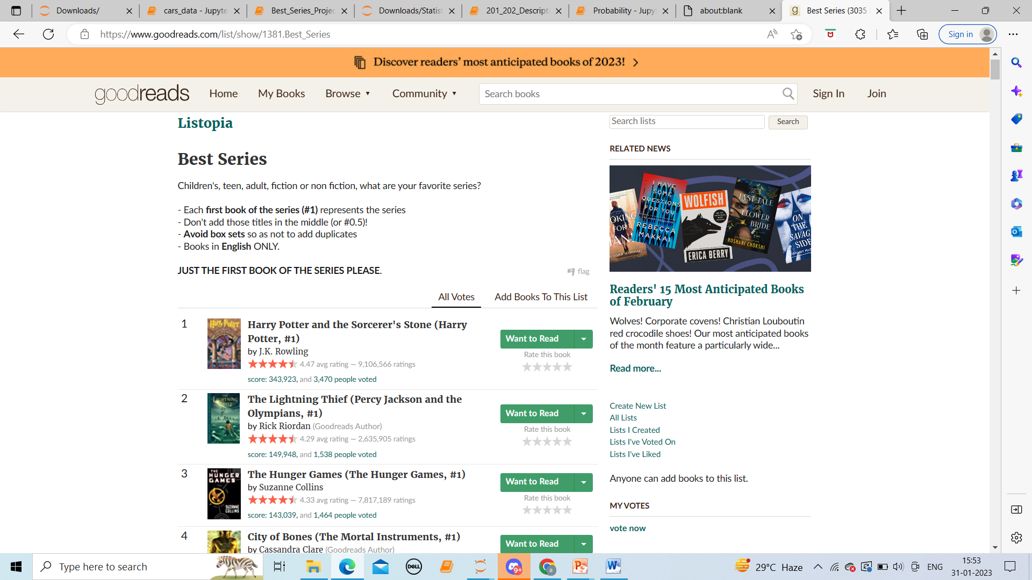
Website view :

Slide 10
Agenda (This should be the PPT flow)
Business Problem and Use case domain understanding(If Required)
Objective of the Project
Web Scraping – Details (Websites, Processor you followed)
Summary of the Data
Exploratory Data Analysis:
Data Cleaning Steps
Data Manipulation Steps
Univariate Analysis Steps
Bivariate Analysis Steps
Key Business Question
Conclusion (Key finding overall)
Q&A Slide
Your Experience/Challenges working on Web Scraping – Data Analysis Project.

Slide 11
TYETEYYRTRT3E

Slide 13

THANK YOU

